Slide 1

INSTRUCTOR ONBOARDING!!!
We are so glad to have you here!

Slide 2

What’s in store!
Who are we and what we are about!
What to expect on your first session!
What to expect going forward!
Accessing webinars and troubleshooting
How to raise an invoice
Plan for the coming week

Slide 3

Our mission
Founded in 2011, Edureka has evolved into a leading online learning ecosystem for continuing education in the fields of digital marketing, I.T and other technical courses.
We are a platform for both live and self-paced sessions for learners with a 24/7 doubt support system, making us the most effective eLearning system in the world.
“We are committed to you and your progress”

Slide 4

This is where Magic happens!!

Slide 5

Getting started-What to expect on your first session
Using gotowebinar and LMS
Goals for the upcoming batch
How will you be evaluated_Feedback mechanism
Common Learners Comments
Best Practices

Slide 6
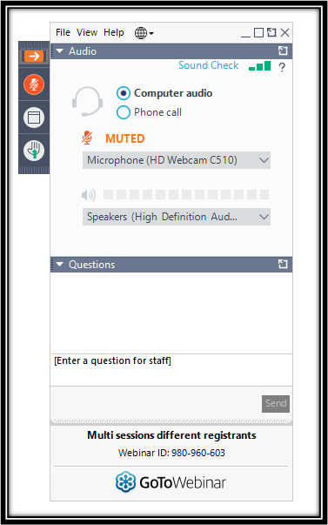

Attendees Panel
Attendees will only be able to hear you, see your screen and post their questions.
Notable Features
Muted by default & Unmuted in the end
Maximize/Minimize Panel
Leave Webinar/Troubleshoot
Question box/Question intervals
Hand Raise

Slide 7
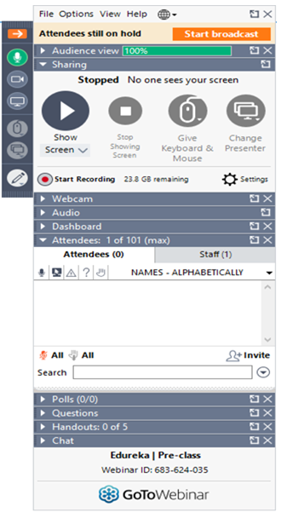
Organizer’s Panel
“Works only in Windows PC and Mac”
Maximize/Minimize Panel.
Mute / Un-mute
Leave / End Webinar
Pause / Freeze screen
Start Recording
Tool Pen
Attendees / Staff column
Docking – Un-docking
Question Panel
Chat Option (Only for sharing links to all)

Slide 8
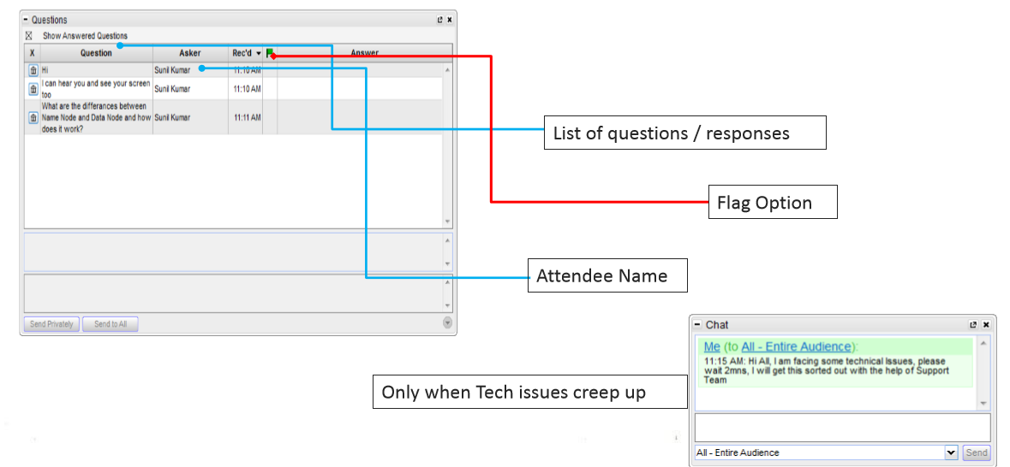
Question Window
While answering questions, please read aloud the learner’s name, followed by the question before answering so that the other learners do not get confused about the flow getting disrupted suddenly.

Slide 9
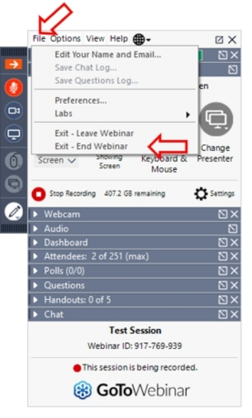

How to “END” a Live Classes?
Step1: Click on the File Menu of the GoToWebinar Control Panel.
Step2: Click on “Exit - End Webinar”. This will terminate the webinar.
Caution: DO NOT Click “Exit - Leave Webinar”. This WILL NOT close the session. The recording will continue and the ATTENDEES WILL STILL BE LIVE. Hence, use this option ONLY IF YOU PLAN TO REJOIN.

Slide 10
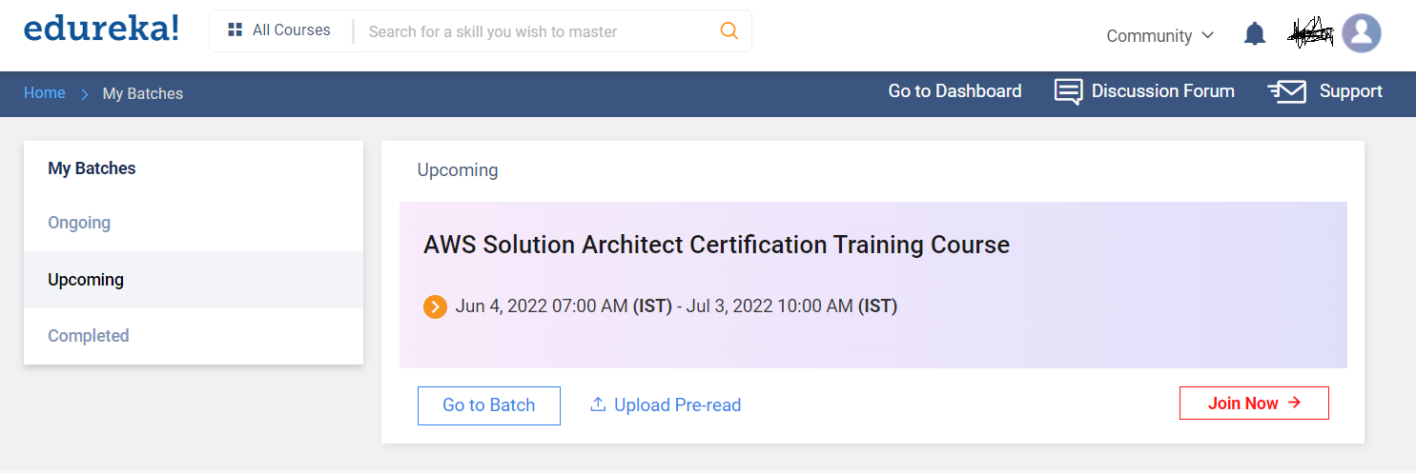
LMS - teach.edureka.co

Slide 11
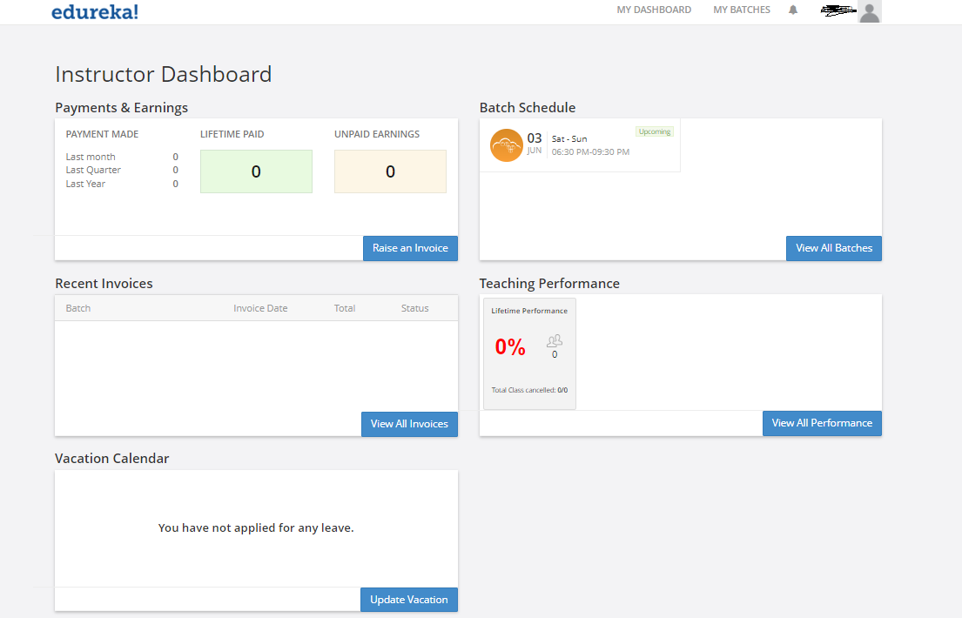

Slide 12
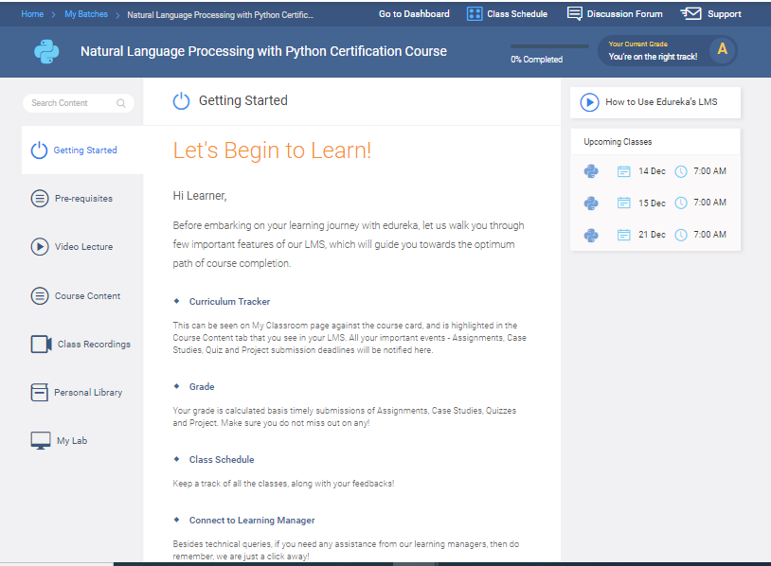
LMS - teach.edureka.co

Slide 13
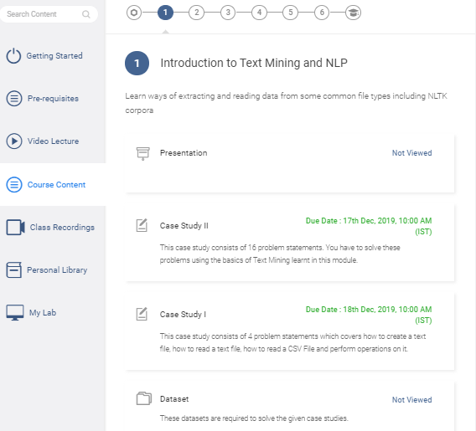
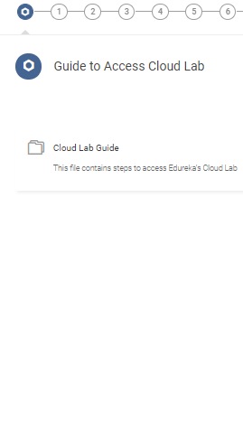

Slide 14
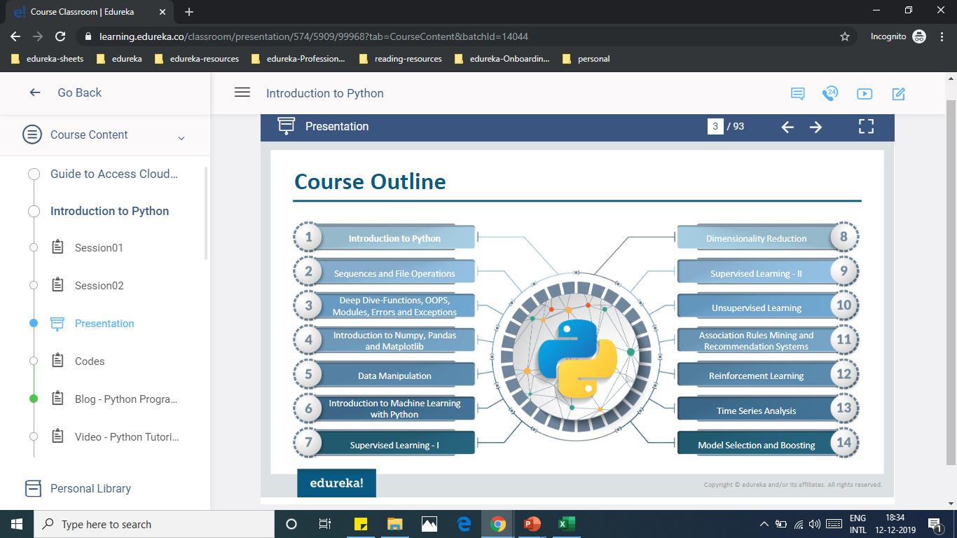
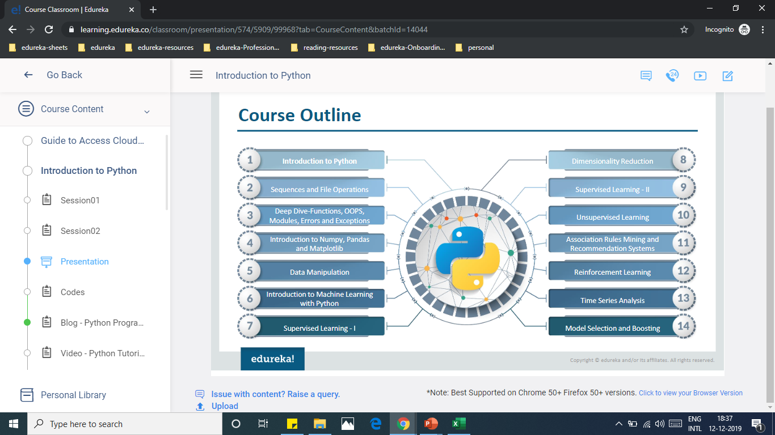
SCROLL DOWN
Notes:
Walkthrough of the LMS

Slide 15
Support Details
For support please contact : +91 9742405555 (Gopal Krishna)
For any login issues during your Class
For any unexpected issues during your class
For any unexpected network issues during your class
Operations email id :
For any concerns related to operations please contact : ops@edureka.co

Slide 16

Important Guidelines
Mandatory Infrastructure:
Wired internet connectivity with speed > 20 MBPS. (www.speedtest.net)
UPS with minimum 3 hrs. backup
A good USB headset with noise cancellation is preferred such as Microsoft LX 3000, Sennheiser, Logitech
Point of Contact:
Operations: ops@edureka.co
Payments: instructorpayments@edureka.co
Content: content@edureka.co

Slide 17

Goals for the upcoming batch
Follow the Edureka content
Follow assigned session timings for start/end/breaks
Follow the policies as stated by Edureka!
Deliver an excellent learning experience
Consistent course delivery

Slide 18
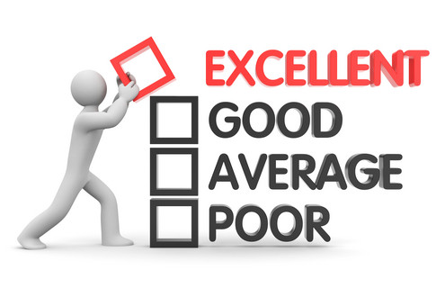
How will you be assessed ?
-Survey Feedbacks
-Learners comments
-Observations and Class Audit

Slide 19
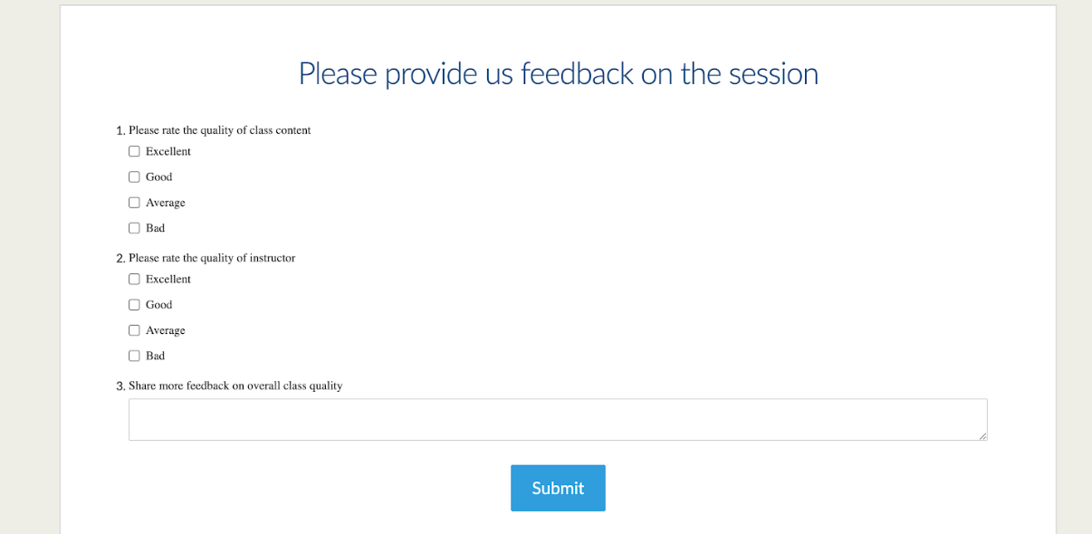
Survey after the Class

Slide 20
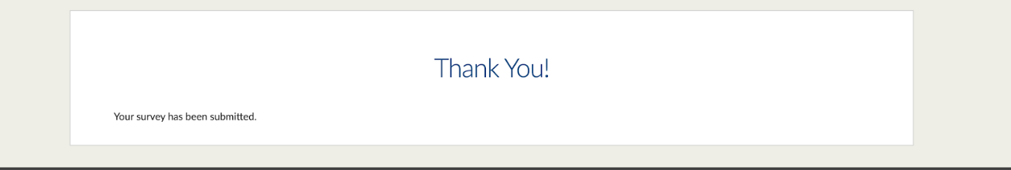
Survey Feedback

Slide 21
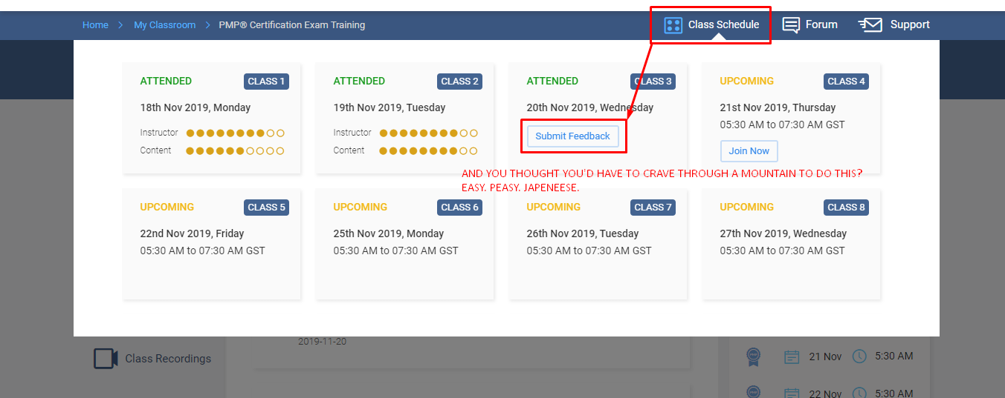
Importance of Learners Feedback
Notes:
Survey feedbacks from mail

Slide 22
Feedback: Instructor Rating
Q1. How do you rate the class?
Q2. How do you rate the Instructor?
Q3. Any further comments?
Batch size = 40
Feedback received = 38*
Promoters (Excellent) = 30*
Neutral (Good) = 04
Detractors (Negative) = 04*
IR = [(30 - 4)/38]*100 = 68 %
IR = X100
Promoters Detractors
Feedback
Rating | score
Excellent | 1
Good | 0
Average | -1
Bad | -1

Slide 23
Payments criteria: Terms and Conditions
For 80% fixed and 20% bonus (variable) or as discussed with the recruitment team.
maintain IR > 50
Avoid Late Logins and Class Cancellations (lead to 20% total reduction & refund requests)
Avoid absconding mid-batch (lead to zero commercials)
Only once your batch is completed, would you be receiving an invoice within 24 hours. Fill the same and revert to instructorpayments@edureka.co
Invoices received between 01st to 15th will be cleared by 23rd of the current month. Incase invoice is received between 16th - last day of the month it would be cleared next month by 12th
Payments will be done Exclusive of GST or TDS to be deducted as per Income Tax Law
i.e. 10% TDS Deduction of the total batch cost (Variable and extra classes included)

Slide 24
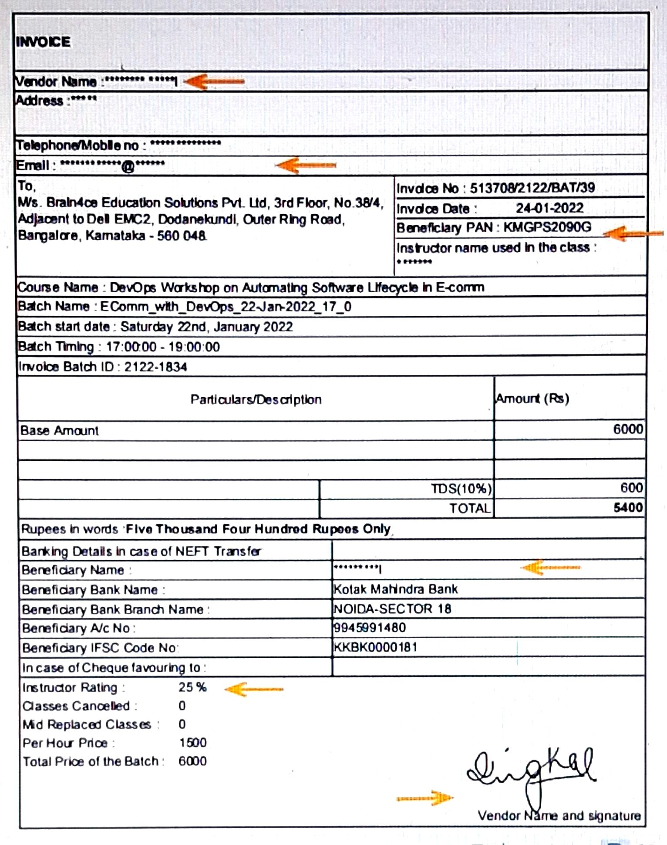
PDF INVOICE
Do not edit the invoice content as it is auto generated from the payments team
For any changes and modification in the content of the invoice reach out to ops@edureka.co
For final submission and payment process reach out to instructorpayments@edureka.co
In case of GST - Individual GST no ,Co GST no and SAC code to be provided

Slide 25
Continued…
While starting a session, do not wait for beyond 2 minutes and minimize background noises
Please avoid asking for participants’ introduction and kindly keep the batch size confidential
Avoid being fully dependant on reading the slides
Please do not ask questions to a specific participant, neither take follow up
Never under-estimate the participants or the power of preparation. Come well prepared!
Practices like forming WhatsApp group, connecting on social media, sharing or exchanging personal contact details with the participants are forbidden due to privacy concerns.

Slide 26
Faculty Manual Review
Content Development
In addition to our slides, you may create or refer your own documents to explain a topic. Any external links need to be verified by Edureka beforehand. Also, using branded or copyrighted content of another organization is discouraged
Error or Modifications
During sessions, if you find error in a slide, please approach it positively and mention that you would get it highlighted and corrected. (Kindly reach content@edureka.co). Please note: Any recommended modifications might take a few months as the content is updated in a fixed cycle
For more materials, extra classes, schedule change, unrealistic queries from participants, updating pseudo name etc, inform “Operations”. This team also handles any out-of-class communication requirements such as schedule updates, additional feedback etc.

Slide 27

Common Learners Comments
Instructor read from the slides
Muting and un-muting : Bothered by irrelevant questions
The instructor rushed through the content/slides
Letting a learner ramble on and on
Going off topic for too long
Instructor did not answer to my questions
Instructor used lot of technical jargons

Slide 28

Always join the session 15 min before start time using the ‘Join Now’ button.
First impression of you from your learner means everything for Day 1
In the first class, greet the participants cheerfully and ask and set expectations around duration, depth of the content, pre-requisites, doubt intervals (15 minutes), hourly breaks and batch heterogeneity
Please ensure that your presentation is structured and well-planned.
Make use of collaborative learning approaches - relate concept to real life settings
Please use the pen tool and Microsoft Whiteborad to make your sessions interesting.
Take full ownership of your class and batch

Slide 29





Name Here
CERTIFICATIONS
List out you professional certifications here!
ACHIEVEMENTS
Please mention your achievements/ Inventions/ Awards/ Events/ Conferences here!
EXPERIENCE
List out your education & professional Experience here!
STRENGTHS Share your strength’s and reason to become instructor here!
Lead Architect
Technology Blogger
Consultant & Trainer
Certified Data Scientist
Innovator and Entrepreneur

Slide 30
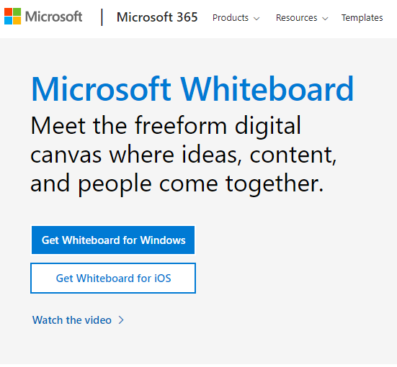
Download: www.microsoft.com/en-in/microsoft-365/microsoft-whiteboard/digital-whiteboard-app
Compatibility
Free Tool
For IOS: Requires iOS 12.0 or above
For Windows: Windows 10 version 14393.0 or above

Slide 31

Continuous Improvement
Review your survey feedback
Find the gap in SKA (Skill,Knowledge,Attitude)
Faculty development
Set the stage
Self Introduction
Setting expectations - agenda/breaks
Get buy in - captivate
Road Map of the course
Content Delivery
Logically organise the main points and add sub points
Use Collaborative learning approaches and gamifications
Wrap Up
Summary
Feedback
Overview of upcoming session
QnA

Slide 32

Resources
Survey Feedback
Participant’s List
Live Sessions
Mock Session - Checklist

Slide 33
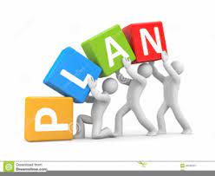
The Coming Week…
-Preclass_Induction Program
-Content Walkthrough
-Live Sessions of ongoing batches
-Mock Practice Session
-Circling back with Team
Training Practices
Tools and access
Feedbacks and improvement ideas

Slide 34

Welcome Onboard!
Have questions?
Feel free to drop us a line! We are happy to help!

